Slide 1
Introduction to Computer Graphics

Slide 2
Books
Computer Graphics: Principles and Practice in C (2nd Edition) by James D. Foley, Andries van Dam, Steven K. Feiner, John F. Hughes
Schaum's Outline of Computer Graphics (2nd Edition) by Zhigang Xiang, Roy A. Plastock
Computer Graphics using OpenGL (2nd/3rd Edition) by Francis S Hill, Jr.

Slide 3
A Brief Overview
Object space vs Image Space
Computer graphics vs Image processing
Computer graphics areas
Modeling: A coffee mug might be described as a set of ordered 3D points along with some interpolation rule to connect the points and a reflection model that describes how light interacts with the mug.
Rendering: creation of shaded images from 3D computer models.
Animation: create an illusion of motion through sequences of images.

Slide 4
Major Application
Video games
Cartoons/Animated flims
Visual effects
CAD/CAM
Simulator: MS flight simulator
Medical imaging

Slide 5
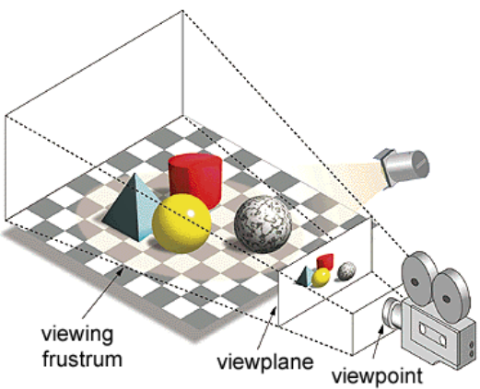
What is Computer Graphics
Model real world
Generate high quality 2d images efficiently, given the 3d model and camera parameters

Slide 6
Background knowledge
Solving equations
Linear algebra
Vector
Trigonometry

Slide 7
Two Approaches
Rasterization
Faster
Pipelined
Ex. Real-time applications
Ray Tracing
High quality and More realistic
Ex. Animation movies

Slide 8
Rasterization Pipeline
Modeling Transformation
View Transformation
Illumination
Projection Transformation
Clipping
Rasterization or Scan conversion
Texturing

Slide 9
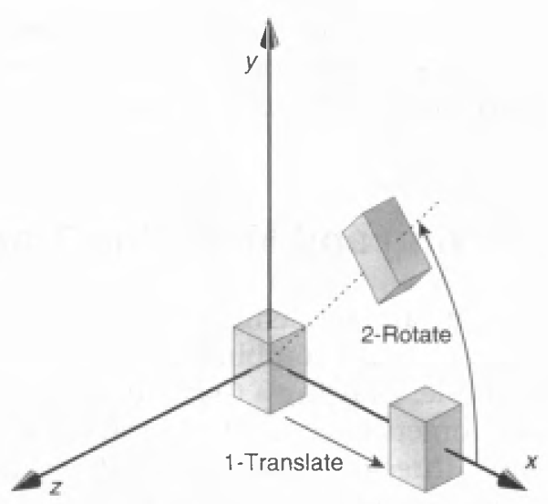
Modeling Transformation
Use transformation to position objects
Reuse objects

Slide 10



Slide 11
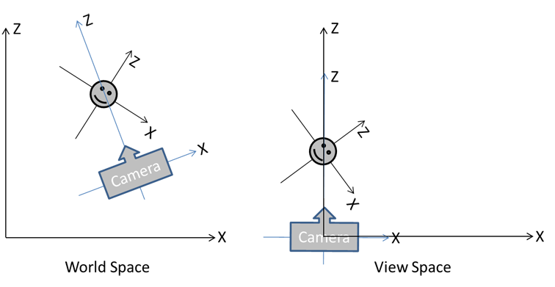
View Transformation
Translate camera to origin
Set view direction along a principal axis

Slide 12
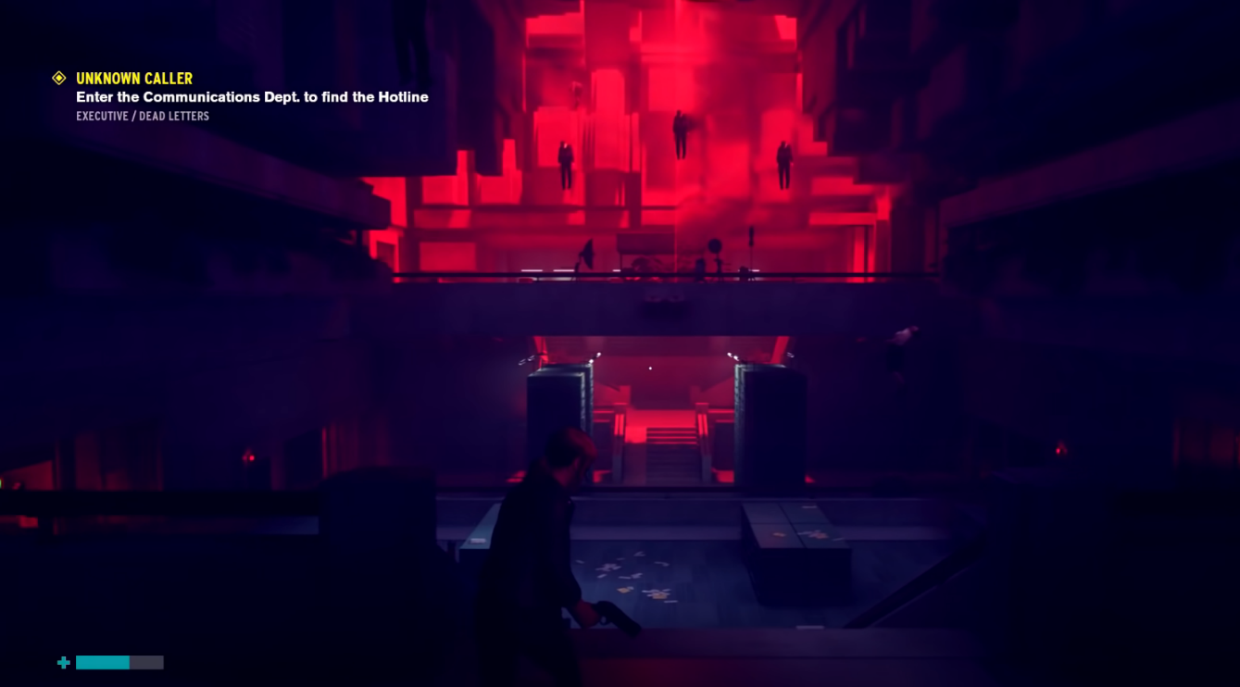


Slide 13
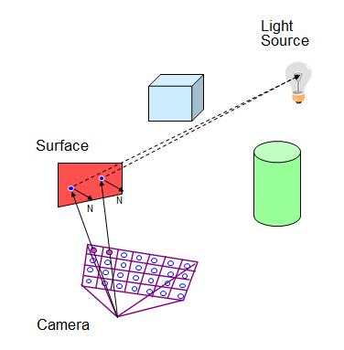
Illumination
Light the scene according to material properties of objects and light sources
Highly important to generate realistic image

Slide 14
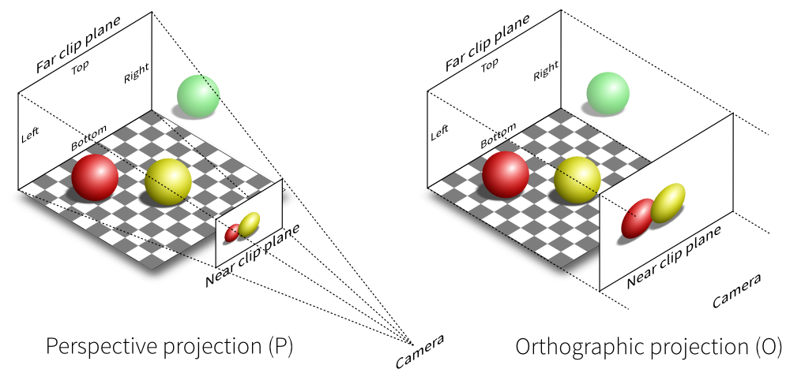
Projection and Clipping
Project the 3d model on a 2d screen
Clip objects outside viewing frustum

Slide 15



Slide 16
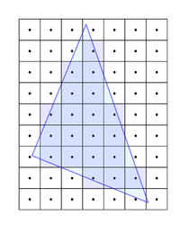
Rasterization
Determine which pixels to light on the screen

Slide 17
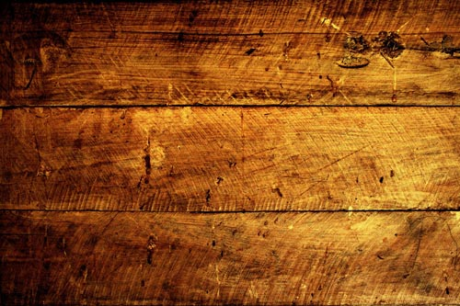
Texturing
Paste images on object surfaces

Slide 18
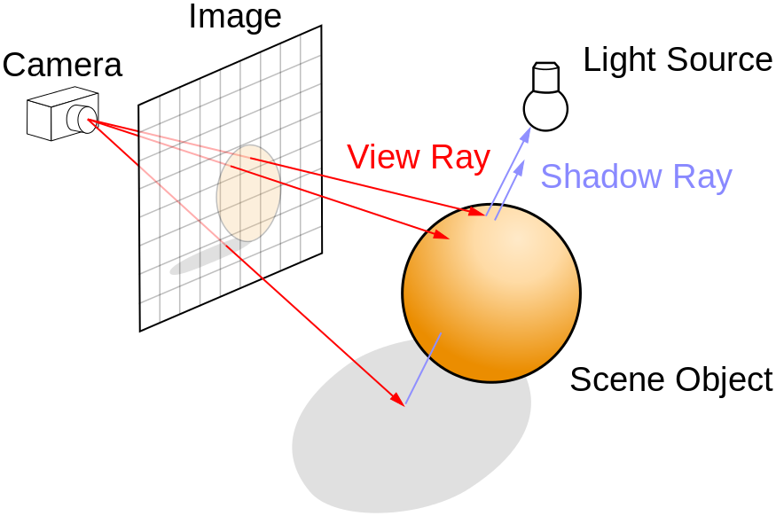
Ray Tracing
Cast rays from eye to each pixel to determine the color of pixel

Slide 19

Ray Tracing
Produces highly realistic image

